Slide 1
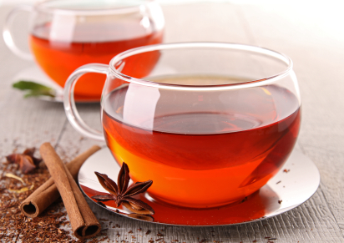
Notes:
Good Morning, Everyone! My name is Sybrand Smit and I would like to share with you 2 years of my research into: (NEXT)
http://www.herbalteasonline.com/wp-content/uploads/2015/03/Red-Rooibos-Tea.jpg

Slide 2
An Investigation into the Effects of Aspalathin on Myocardial Glucose Transport using Cardiomyocytes from Control and Insulin Resistant Rats, and Differentiated H9C2 Cells
Sybrand E. Smit
Biomedical Research and Innovation Platform
Research Symposium 2015
Notes:
“... the effects of Aspalathin on myocardial glucose transport using cardiomyocytes from control and insulin resistant rats, and differentiated H9C2 cells.” (NEXT)

Slide 3
OUTLINE OF TALK
The Growing Problem: Diabetes Type 2
Statistics
Treatment Options
Aspalathin and it’s ANTI-Diabetic Properties
Rooibos
Research History
Experimental Setup
Animal and Cell Models
Cardiomyocyte Isolation and Cell Signalling
Preliminary Results
Notes:
To walk you through the presentation I’d like to discuss:
Type 2 Diabetes and some of the prevention strategies;
Aspalathin and it’s rationale as a potential anti-diabetic drug;
The specific techniques, animal and cell models used in my research;
And lastly, what the findings of the research has been to date (NEXT)

Slide 4
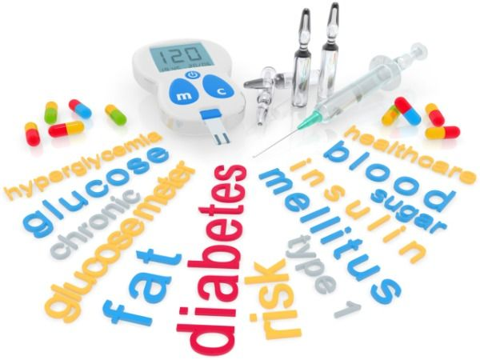
Notes:
We are all aware that too much of anything, is a bad thing. In the case of Type 2 Diabetes (NEXT)
http://fitness.makeupandbeauty.com/wp-content/uploads/2013/06/aboutdiabetes1_600x450.jpg

Slide 5
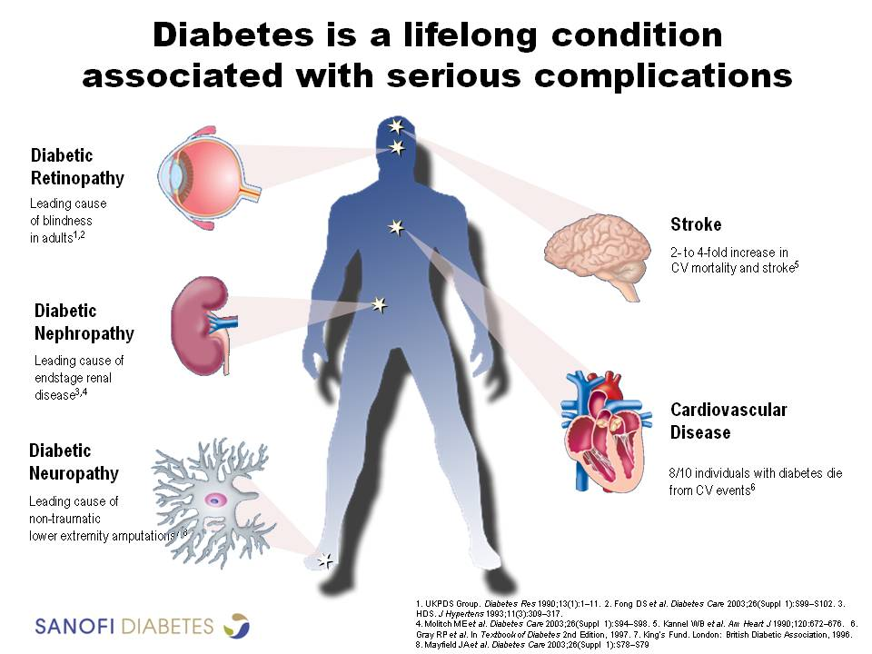
Notes:
, too much glucose in the blood, can give rise to various problems, including insulin insensitivity, damaged nerves and arteries, and all of these increase your risk for heart attacks and strokes. (NEXT)
http://www.sanofidiabetes.in/images/hcp/Comorbid-2.jpg

Slide 6

DIABETES STATISTICS
People with Type 2 Diabetes
Heart disease or strokes
4 times more likely
cause of death in more than 65% of patients
1.5 million deaths in 2012
CONTROLLABLE RISK FACTOR
Notes:
It is estimated that people with type 2 diabetes are 4 times more likely to die of heart disease or stroke, and at least 65 percent of people with diabetes die from these complications. In 2012 alone, 1.5 million deaths globally were attributed to Diabetes.
All of this being said, Diabetes remain one of the major controllable risk factors for cardiovascular disease. (NEXT)
http://honor.americanheart.org/images/content/pagebuilder/black_red_AHA_logo_with_black_tag.png

Slide 7
THE ANSWER?
Notes:
So, how do we control diabetes? Quite simply.. As always (NEXT)

Slide 8
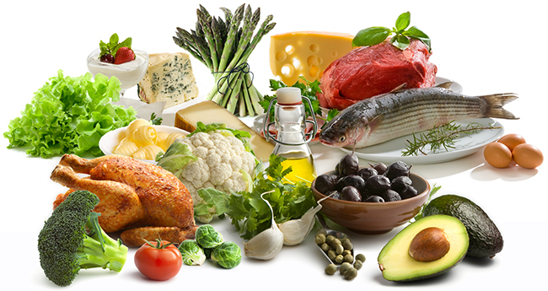
DIET
Notes:
Through Diet (NEXT)
http://www.dietdoctor.com/wp-content/uploads/2013/02/riktigmat.jpg

Slide 9

EXERCISE
Notes:
And Exercise. (NEXT)
http://www.manhattangmat.com/blog/wp-content/uploads/HiRes2.jpg

Slide 10
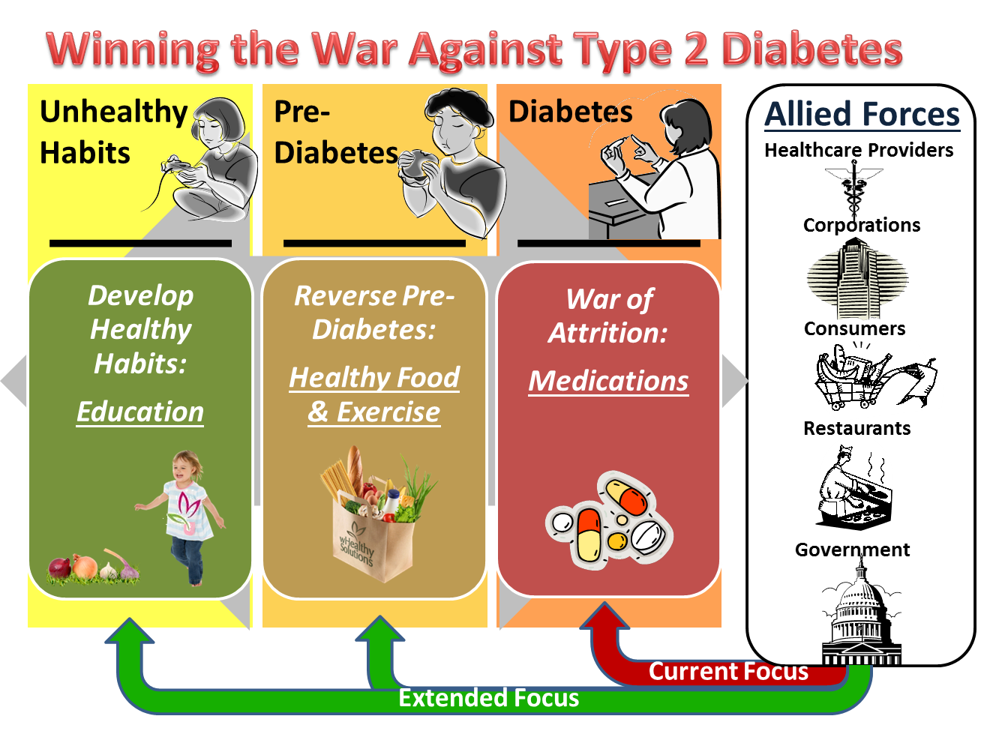
Winning the War Against Type 2 Diabetes
Notes:
However, if healthy living fails... it becomes the hope of medicine together with ongoing research to prevent further deterioration of health in diabetic patients. (NEXT)
http://images.huffingtonpost.com/2013-01-29-Winning_Diabetes_Type2.png

Slide 11
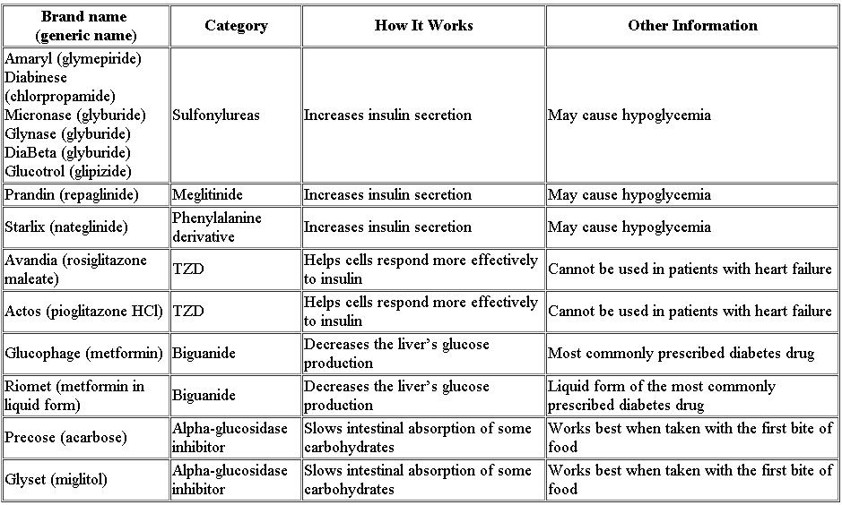
MEDICATION AVAILABLE
Notes:
Now, various medications are already prescribed to treat Type 2 Diabetes, each with it’s own set of pros and cons. (NEXT
https://nfb.org/images/nfb/publications/vod/vod_22_4/vodfal0712.htm

Slide 12
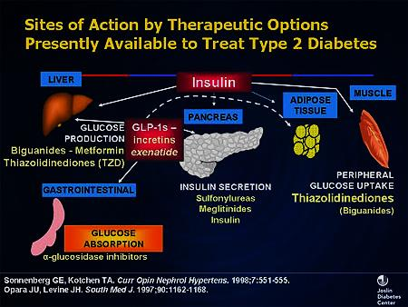
Notes:
Each of these medications have a different mode of action stretching from:
enhancing insulin action in peripheral tissues
enhancing the amount of insulin secreted by the body
suppressing glucose production
and also by delaying the absorption of carbohydrates after meals (NEXT)
http://img.medscape.com/slide/migrated/editorial/cmecircle/2007/7047/images/slide6.jpg

Slide 13
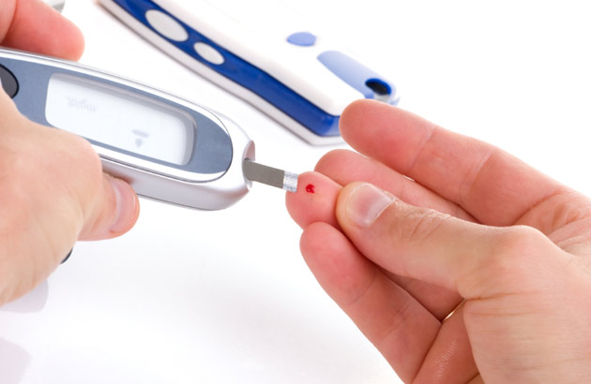
Notes:
The biggest problem with these medications are that they are only treatments, but not in themself a cure. (NEXT)
http://www.thenewstribe.com/wp-content/uploads/2013/11/Diabetes-is-killing-one-patient-every-six-seconds.jpg

Slide 14
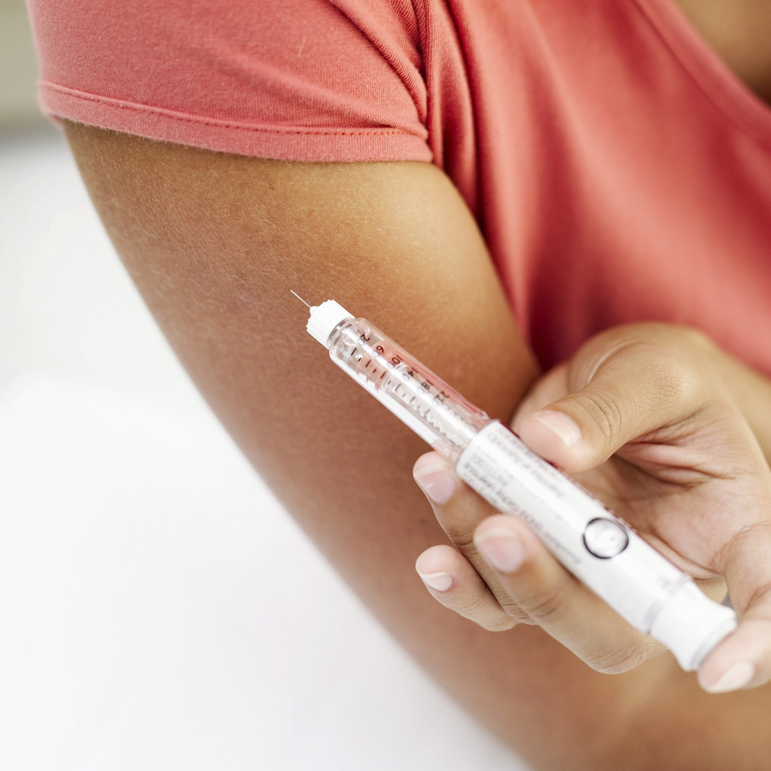
Notes:
There’s also high costs involved with being dependent on these medications, (NEXT)
http://medimoon.com/wp-content/uploads/2012/10/injection.jpg

Slide 15
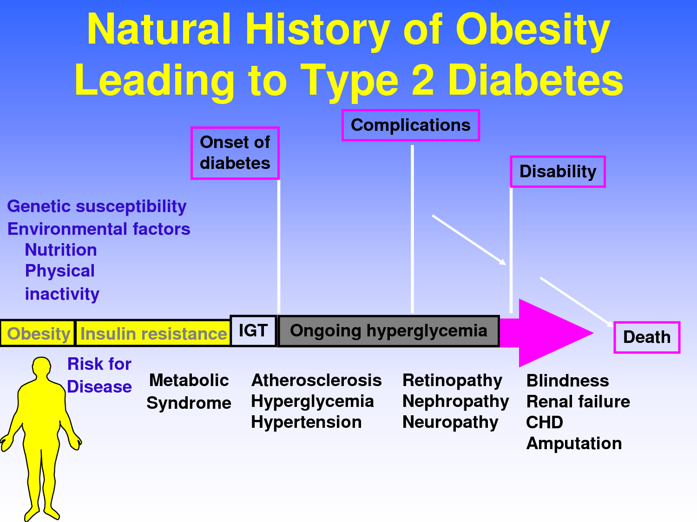
PROGRESSION OF DIABETES
Notes:
and prolonged use can carry the risk of weakening the heart and causing liver toxicity (NEXT)
http://www.bloodsugar-levels.com/wp-content/uploads/2014/03/type-2-diabetes-history.png

Slide 16
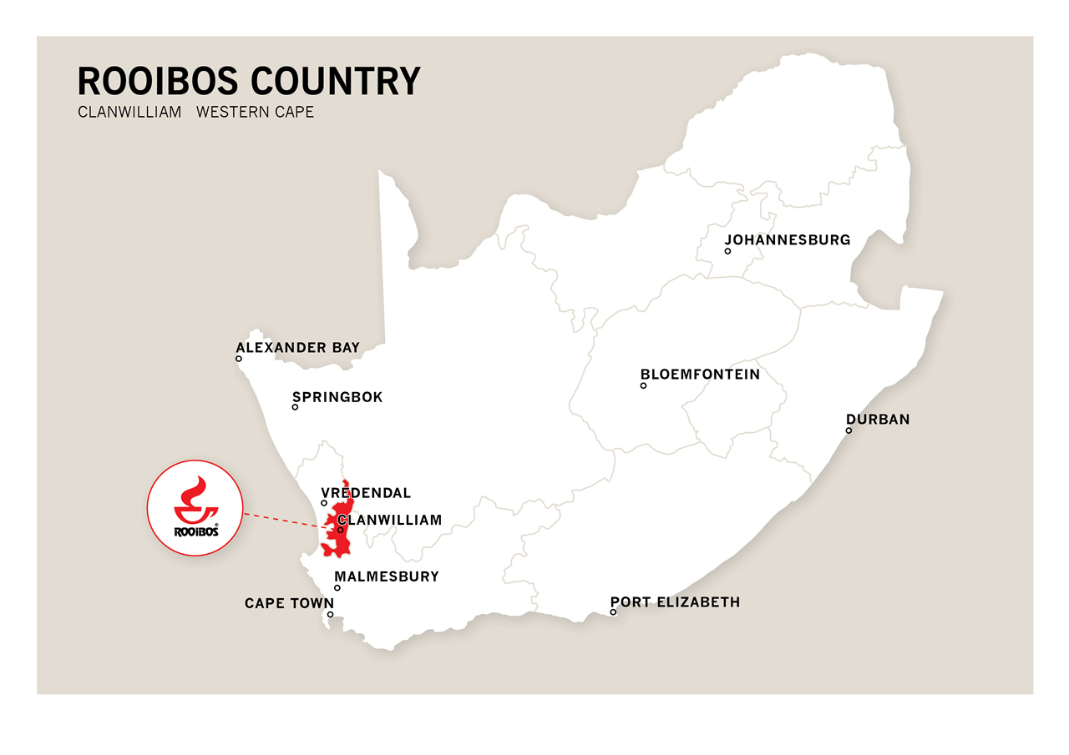
Notes:
SO, The diabetic journey brings us to our humble country, where Rooibos might bring new hope. (NEXT)
http://www.rooibosltd.co.za/rooibos-images/about-rooibos/Region/1%20Rooibos%20country%20map.jpg

Slide 17
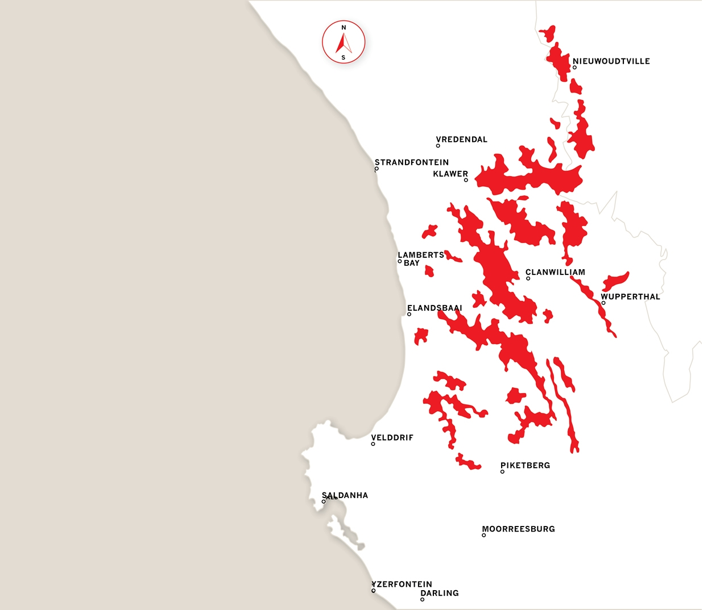
Rooibos
(Aspalathin Linearis)
Notes:
Rooibos (or Aspalathin Linearis) is indigenous to the Western Cape Region of South Africa.
(NEXT)
http://www.rooibosltd.co.za/rooibos-images/about-rooibos/Region/2%20Rooibos%20field%20map.jpg

Slide 18
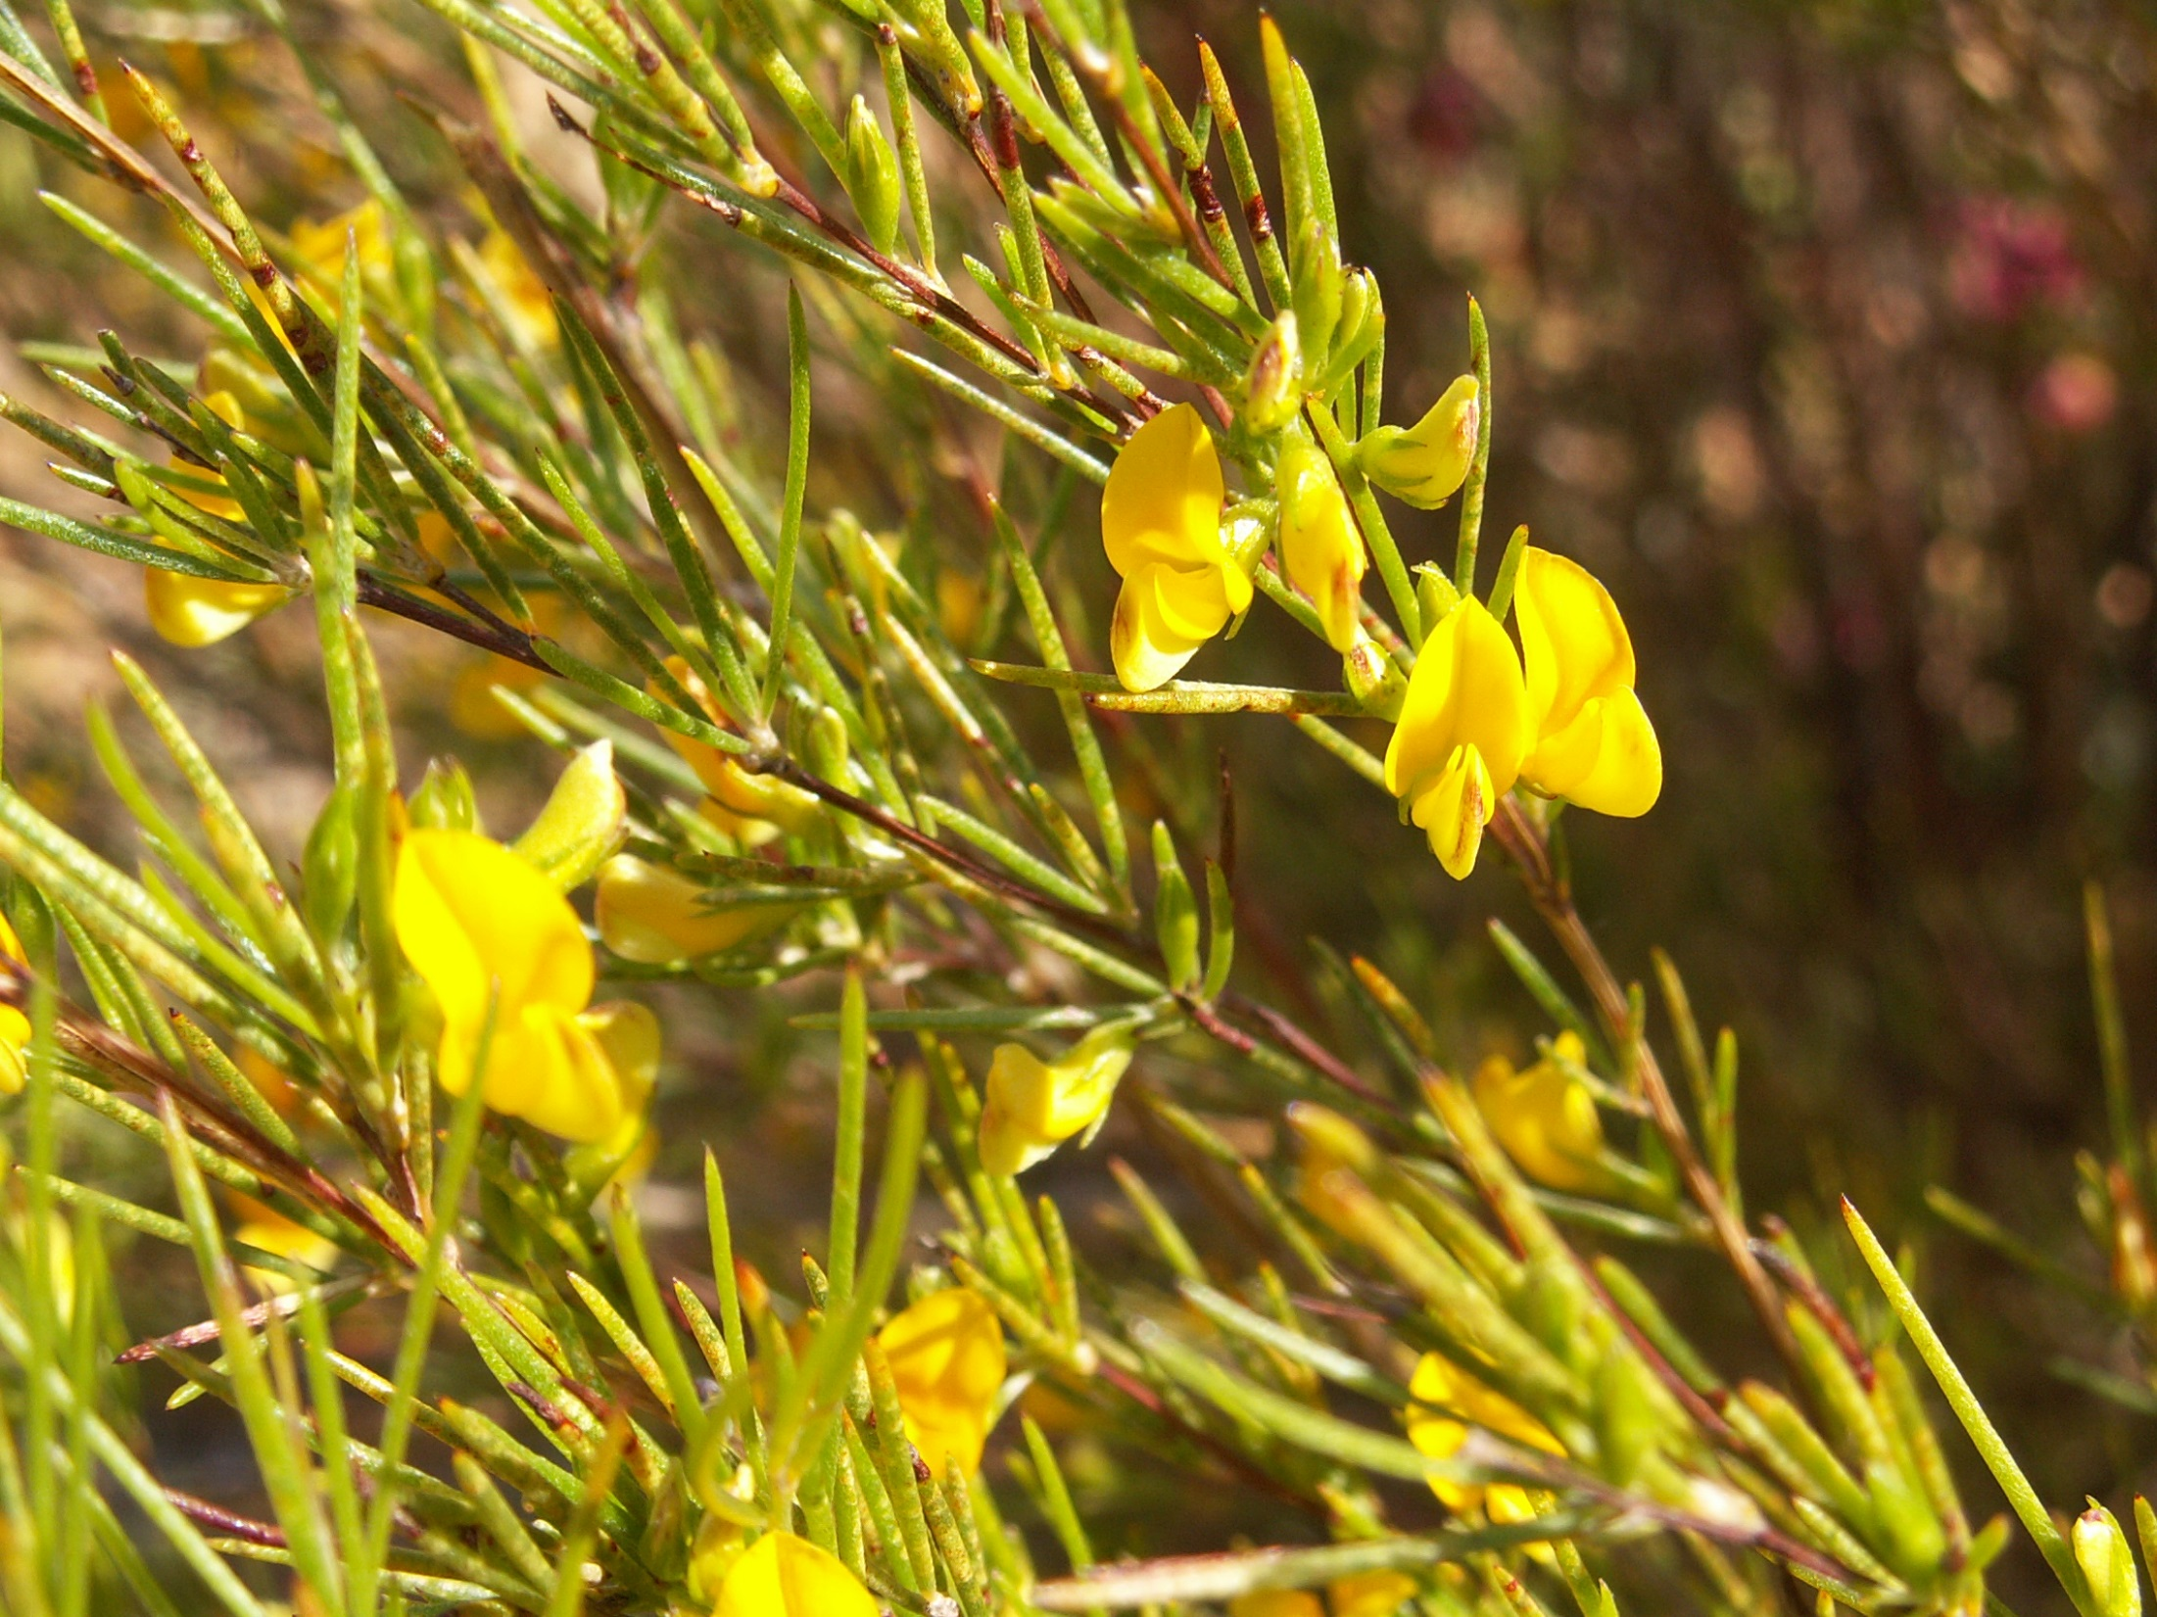
Notes:
The plant is most commonly consumed as a herbal infusion, by which hot water is added to the “fermented” rooibos tea to extract the inherent polyphenols. It has been shown, however, that through this process of fermentation the polyphenolic content of the plant is severely diminished, consequently reducing the plants anti-oxidative capacity. Lately, there has been a shift towards consuming the green or unfermented rooibos and it’s also the choice of grade when isolating aspalathin. (NEXT)
http://http://www.herbalteasonline.com/wp-content/uploads/2015/03/Rooibos-Plant.jpg

Slide 19
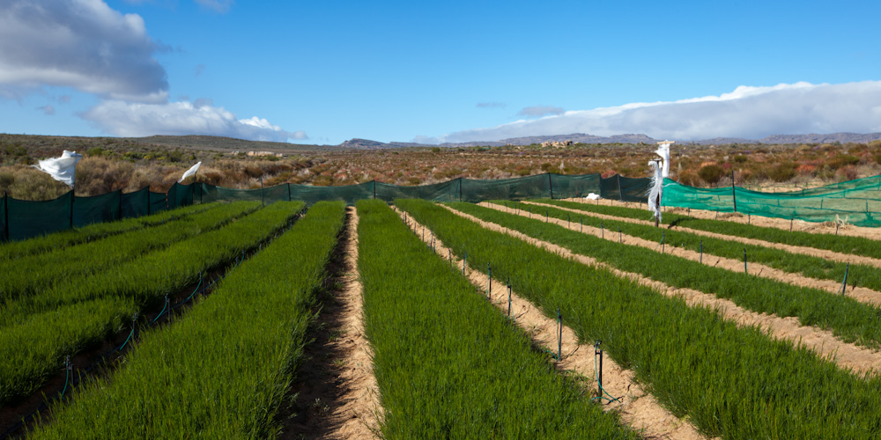
Notes:
The plant is most commonly consumed as a herbal infusion, by which hot water is added to the “fermented” rooibos tea to extract the inherent polyphenols. It has been shown, however, that through this process of fermentation the polyphenolic content of the plant is severely diminished, consequently reducing the plants anti-oxidative capacity. Lately, there has been a shift towards consuming the green or unfermented rooibos and it’s also the choice of grade when isolating aspalathin. (NEXT)
http://www.klipopmekaar.co.za/wp-content/uploads/2012/07/Tea-planting-8-2.jpg

Slide 20
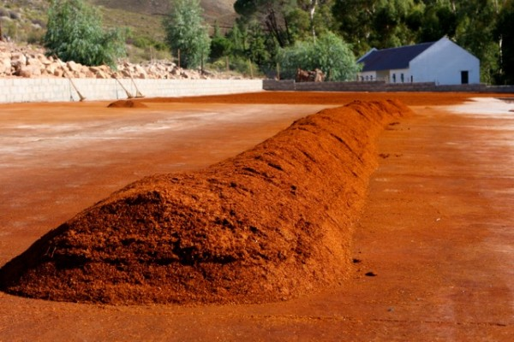
Notes:
The plant is most commonly consumed as a herbal infusion, by which hot water is added to the “fermented” rooibos tea to extract the inherent polyphenols. It has been shown, however, that through this process of fermentation the polyphenolic content of the plant is severely diminished, consequently reducing the plants anti-oxidative capacity. Lately, there has been a shift towards consuming the green or unfermented rooibos and it’s also the choice of grade when isolating aspalathin. (NEXT)
http://camellia-sinensis.com/carnet/wp-content/uploads/2013/04/IMG_0645-600x400.jpg

Slide 21
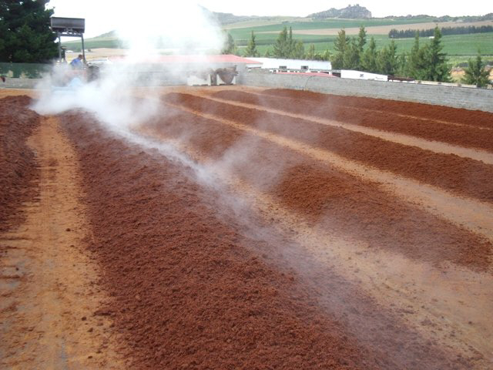
Notes:
The plant is most commonly consumed as a herbal infusion, by which hot water is added to the “fermented” rooibos tea to extract the inherent polyphenols. It has been shown, however, that through this process of fermentation the polyphenolic content of the plant is severely diminished, consequently reducing the plants anti-oxidative capacity. Lately, there has been a shift towards consuming the green or unfermented rooibos and it’s also the choice of grade when isolating aspalathin. (NEXT)
http://www.showcook.com/2011/in-the-news/in-the-news-franklin-larey/

Slide 22
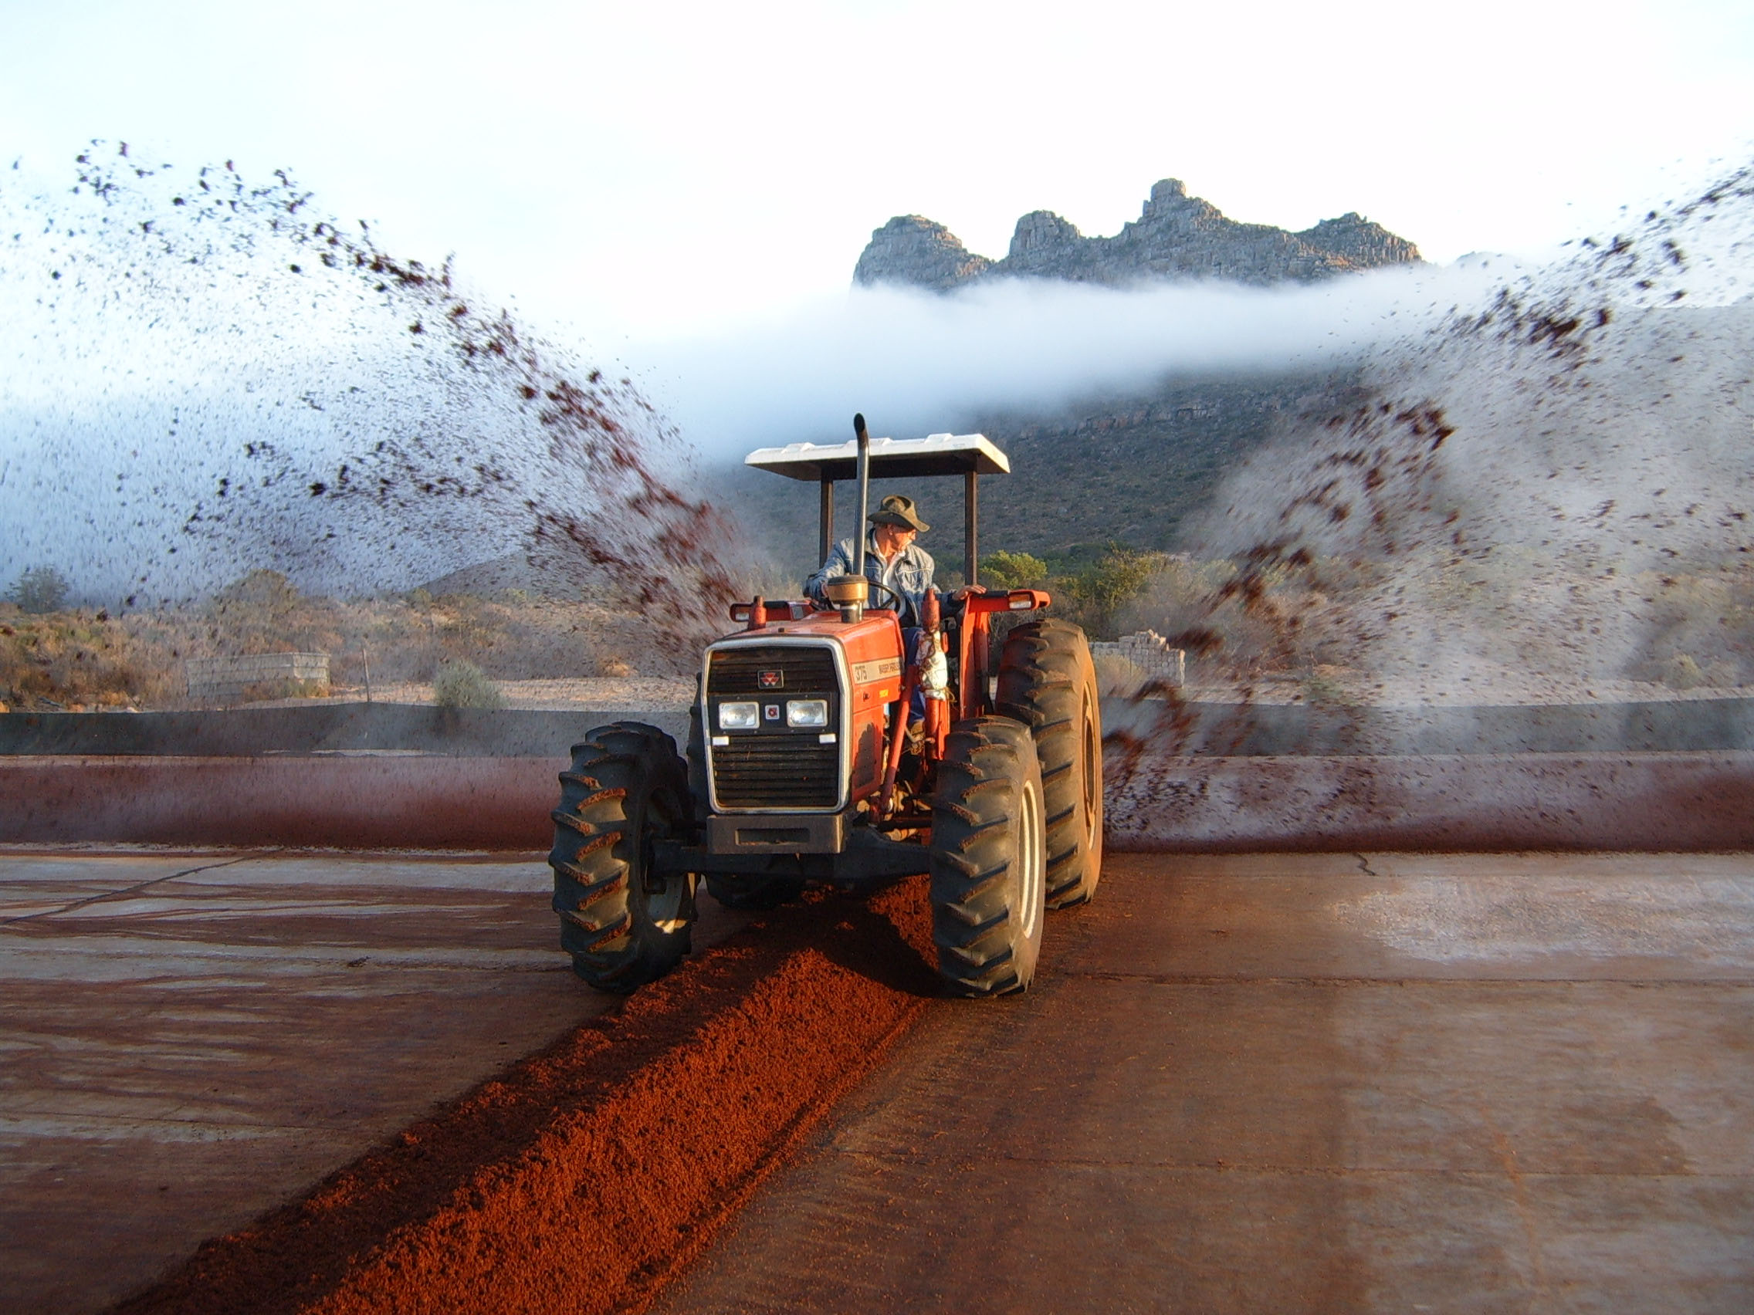
Notes:
The plant is most commonly consumed as a herbal infusion, by which hot water is added to the “fermented” rooibos tea to extract the inherent polyphenols. It has been shown, however, that through this process of fermentation the polyphenolic content of the plant is severely diminished, consequently reducing the plants anti-oxidative capacity. Lately, there has been a shift towards consuming the green or unfermented rooibos and it’s also the choice of grade when isolating aspalathin. (NEXT)
http://www.kingsproducts.co.za/html/images/pick_13_b.jpg

Slide 23
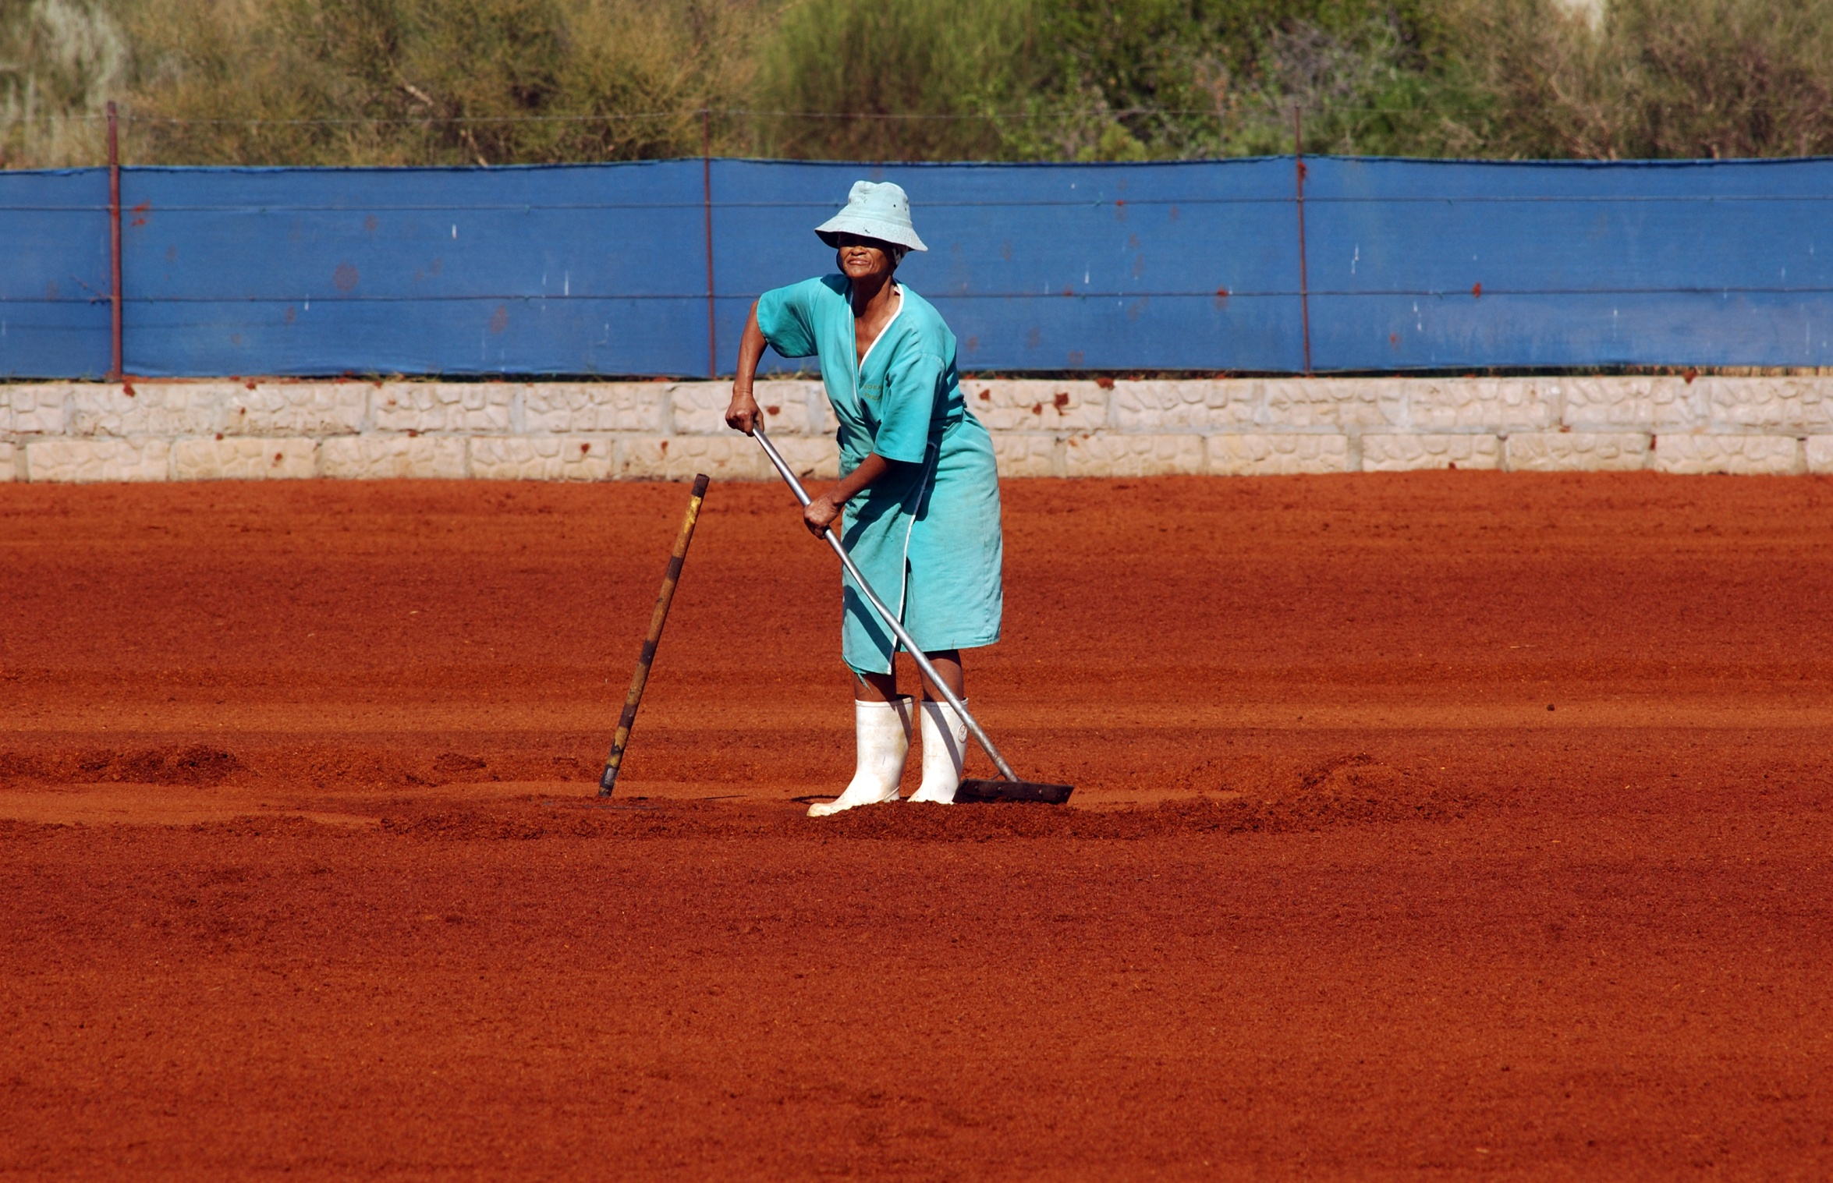
Notes:
The plant is most commonly consumed as a herbal infusion, by which hot water is added to the “fermented” rooibos tea to extract the inherent polyphenols. It has been shown, however, that through this process of fermentation the polyphenolic content of the plant is severely diminished, consequently reducing the plants anti-oxidative capacity. Lately, there has been a shift towards consuming the green or unfermented rooibos and it’s also the choice of grade when isolating aspalathin. (NEXT)
http://findtripinfo.com/africantravel/wp-content/uploads/2012/07/rooibos-harvest-worker-western-cape1.jpg

Slide 24
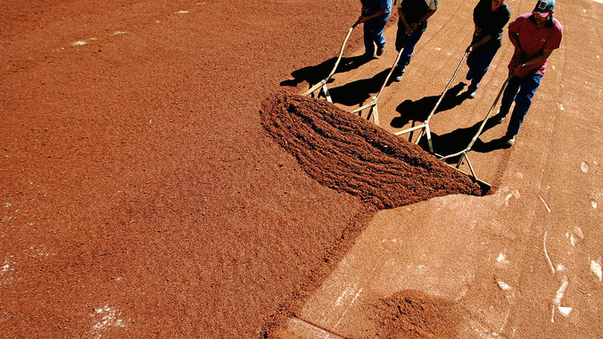
Notes:
The plant is most commonly consumed as a herbal infusion, by which hot water is added to the “fermented” rooibos tea to extract the inherent polyphenols. It has been shown, however, that through this process of fermentation the polyphenolic content of the plant is severely diminished, consequently reducing the plants anti-oxidative capacity. Lately, there has been a shift towards consuming the green or unfermented rooibos and it’s also the choice of grade when isolating aspalathin. (NEXT)
http://cdn.mg.co.za/crop/content/images/2013/08/01/rooibosi2e.jpg/676x380/

Slide 25
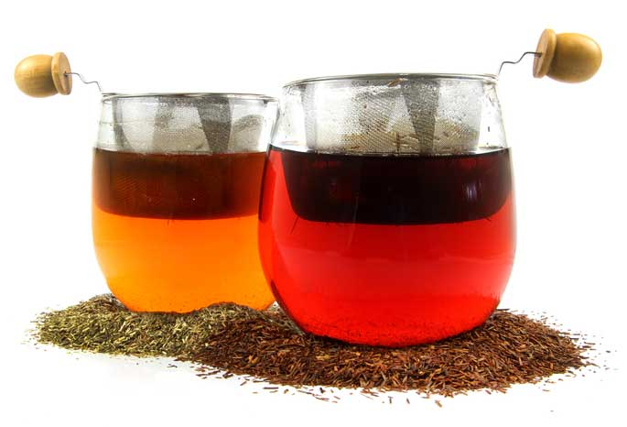
RED
GREEN
Notes:
The plant is most commonly consumed as a herbal infusion, by which hot water is added to the “fermented” rooibos tea to extract the inherent polyphenols. It has been shown, however, that through this process of fermentation the polyphenolic content of the plant is severely diminished, consequently reducing the plants anti-oxidative capacity. Lately, there has been a shift towards consuming the green or unfermented rooibos and it’s also the choice of grade when isolating aspalathin. (NEXT)
http://mountainrose.wpengine.netdna-cdn.com/wp-content/uploads/2012/02/rooibos.jpg

Slide 26
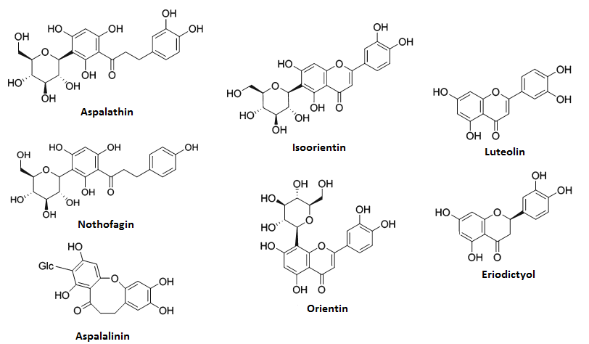
COMPOUNDS IN ROOIBOS
Notes:
Of the various compounds within Rooibos, Aspalathin is the most prominent polyphenol and the biggest contributor to rooibos’ beneficial effects (NEXT).
http://e004777c130eade00234-5ddb36df15af65ab8482e83373c53fe5.r41.cf1.rackcdn.com/images/393.png

Slide 27
HISTORY OF ASPALATHIN
1965 – Structure Determined NMR (Koepen et al.)
1996 – Structure Determined HPLC (Joubert et al.)
1997 – Antioxidant Activity (Von Gadow et al.)
2003 – Antioxidant Activity (Schultz et al.), (Bramati et al.)
2003 – Extraction Kinetics (Jaganyi et al.)
2004 – Anti-Radical Capacity (Joubert et al.)
2005 – Suppression of Skin Tumour Growth (Marnewick et al.)
2005 – Pro-oxidant (Joubert et al.)
2006 – Estrogenic Effect (Shimamura et al.)
2006 – Anti-mutagenic Effect (Van Der Merwe et al.)
2007 – Anti-mutagenic Effect (Snijman et al.)
2008 – Metabolism in Pigs (Kreuz et al.)
2008 – Transport across Epithelium Layers (Huang et al.)
2009 – Stimulates Glucose Uptake and Insulin Secretion (Kawano et al.)
2009 – Bioavailability of Aspalathin in Humans (Stalmach et al.)
2009 – Anti-oxidant Activity (Snijman et al.)
2009 – Anti-oxidant Activity and Anti-inflammatory Effects (Baba et a.)
2010 – Anti-oxidant Activity of Metabolites (Van der Merwe et al.)
2010 – Anti-oxidant Activity (Darvesh et al.)
2011 – Suppression of Skin Tumour Growth (Sissing et al.)
2011 – Anti-oxidant Activity and Bioavailability in Humans (Breiter et al.)
2011 – Cardiac Protection Against Ischemia Reperfusion (Pantsi et al.)
2012 – Stimulates Glucose Uptake (Muller et al.)
2012 – Anti-oxidant Activity (Joubert et al.)
2012 – Influences Steroidogenesis (Schloms et al.)
2013 – Anti-oxidant Activity (Chen et al.)
2013 – Stimulates Glucose Uptake, Mitochondrial Activity, ATP Production (Mazibuko et al.)
2013 – Hypoglycemic Effect, Glut 4 Translocation, AMPK Activation. Reduction in Hepatic Enzymes,
Reduction in Lipogenesis and Glucose Production (Son et al.)
2013 – Inhibits Xanthine Oxidase, Lowers Plasma Uric Acid Levels (Kondo et al.)
2014 – Inhibits Steroidogenesis (Schloms et al.)
2014 – Anti-oxidant Activity (Dludla et al.)
2015 – Anti-inflammatory effects in Endothelial Cells (Kwak et al.)
2015 – Vascular Anti-inflammatory effects (Lee et al.)
Notes:
Aspalathin was first isolated and characterised in 1965 by Koepen at al. and since then has amounted about 60 mentions in research, alot of which were studies done with fermented and unfermented rooibos. (NEXT)

Slide 28
HISTORY OF ASPALATHIN
Structure Determined
1965 – NMR (Koepen et al.)
1996 – HPLC (Joubert et al.)
Antioxidant Activity
1997 – (Von Gadow et al.)
2003 – (Schultz et al.), (Bramati et al.)
2004 – (Joubert et al.)
2009 – (Snijman et al.), + Anti-inflammatory Effects (Baba et al.)
2010 – (Van der Merwe et al.)
2010 – (Darvesh et al.)
2011 – (Breiter et al.)
2012 – (Joubert et al.)
2013 – (Chen et al.)
2014 – (Dludla et al.)
2015 – (Kwak et al.)
2015 – (Lee et al.)
Extraction Kinetics
2003 – (Jaganyi et al.)
Pro-oxidant
2005 – (Joubert et al.)
Estrogenic Effect
2006 – (Shimamura et al.)
Inhibits Steroidogenesis
2012 – (Schloms et al.)
2014 – (Schloms et al.)
Anti-mutagenic Effect
2005 – Supression of Skin Tumour Growth (Marnewick et al.)
2006 – (Van Der Merwe et al.)
2007 – (Snijman et al.)
2011 – Suppression of Skin Tumour Growth (Sissing et al.)
Bioavailability
2008 – in Pigs (Kreuz et al.)
2009 – in Humans (Stalmach et al.)
2011 – in Humans (Breiter et al.)
Transport across Epithelium Layers
2008 – (Huang et al.)
Stimulates Glucose Uptake
2009 – + Insulin Secretion (Kawano et al.)
2012 – (Muller et al.)
2013 – + Mitochondrial Activity, ATP Production (Mazibuko et al.)
2013 – + Glut 4 Translocation, AMPK Activation. Reduction in Hepatic Enzymes, Reduction in Lipogenesis and Glucose Production (Son et al.)
Cardiac Protection Against Ischemia Reperfusion
2011 – (Pantsi et al.)
Inhibits Xanthine Oxidase, Lowers Plasma Uric Acid Levels
2013 – (Kondo et al.)
Antioxidant Activity
Bioavailability
Stimulates Glucose Uptake
Cardiac Protection Against Ischemia
Reperfusion
Notes:
Of these articles, about 33 are of direct relevance to my research. The major effects attributed to Aspalathin is its strong antioxidant capacity and also, its ability to stimulate glucose uptake in skeletal muscle cells. (NEXT)

Slide 29
AIMS
1. Can Aspalathin induce Glucose Uptake in both healthy and compromised heart cells?
2. If so, through which cellular mechanism does this occur?
Notes:
This brings me to the aims of my research. We want to find out whether aspalathin can induce glucose uptake in both healthy and compromised heart cells. And if so, through which cellular mechanism does this occur.

Slide 30
EXPERIMENTAL PROCEDURE
Notes:
(NEXT) To have done my research, I made use of three groups of animals:
Young controls of at least 220g and 10 weeks of age
One group with 16 – 30 week diet-induced obesity and insulin resistance; and
An age-matched control group.
(NEXT)

Slide 31
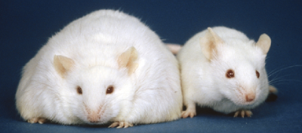
WISTAR RAT MODEL
Young Rats (>220g; >10 weeks)
HFD Rats (Obese and Insulin-Resistant Rats)
16 Week – 30 Week Diet
Control Rats (Age-matched to HFD Rats)
 | Fat (g/100g) | Cholesterol (mg/100g) | Protein (%) | CHO (%) | Sugar (g/100g) | Energy (kJ/100g)
Control | 4.8 | 3 | 17.1 | 34.6 | 6.6 | 1272
High-Fat, High Caloric Diet | 11.5 | 13 | 8.3 | 42 | 24.4 | 1354
Notes:
(NEXT) To have done my research, I made use of three groups of animals:
Young controls of at least 220g and 10 weeks of age
One group with 16 – 30 week diet-induced obesity and insulin resistance; and
An age-matched control group.
(NEXT)
http://aws.labome.com/figure/te-113-4.png

Slide 32
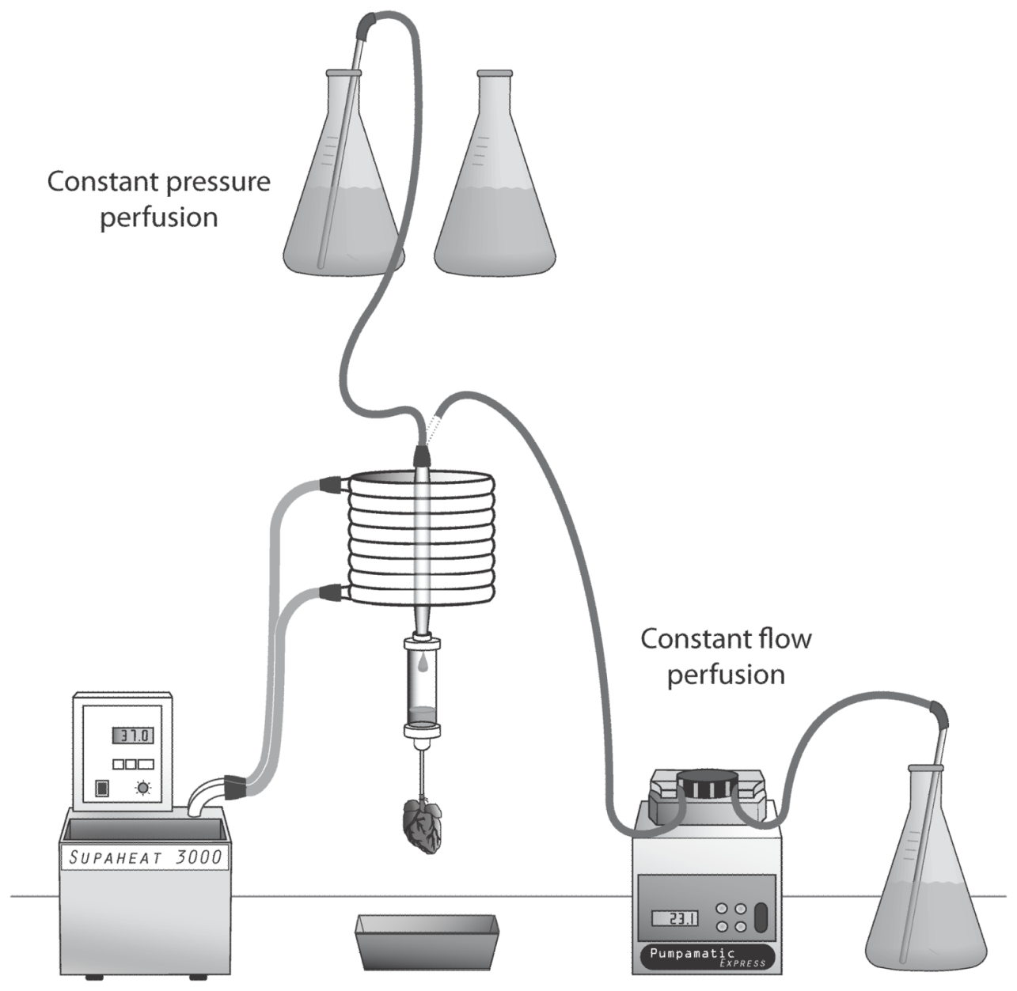
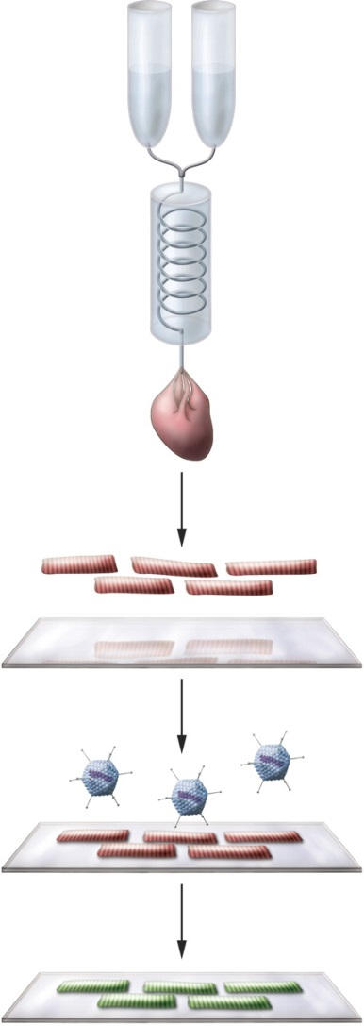
CARDIOMYOCYTE ISOLATION
Notes:
SLIDE 32-33 (45s)
The first part of all the experiments is to isolate the Cardiomyocytes. We do this by using a Langendorff Perfusion System, by which we use solutions with enzymes, such as collagenase to perfuse and digest the dissected heart. The cardiomyocytes can then be stabilized and used in subsequent experiments. (NEXT)
Methods in Cardiomyocyte Isolation, Culture, and Gene Transfer
William E. Loucha,b, Katherine A. Sheehanc, and Beata M. Wolskac,d
aInstitute for Experimental Medical Research, Oslo University Hospital Ullevaal,
J Mol Cell Cardiol. 2011 September ; 51(3): 288–298. doi:10.1016/j.yjmcc.2011.06.012.
http://physrev.physiology.org/content/physrev/88/4/1567/F4.large.jpg

Slide 33
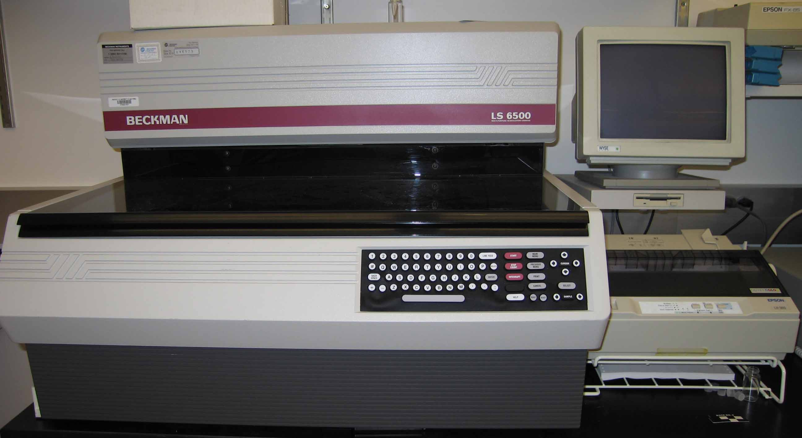
2-DEOXY-[³H]-GLUCOSE UPTAKE
Notes:
To determine glucose uptake, cells were treated with tritiated 2-deoxyglucose and analyzed using liquid scintillation counting. (NEXT)
http://www2.bren.ucsb.edu/~keller/images/Beckman_scintillation.jpg

Slide 34
N=3
*** : p<0.001
** : p<0.01
* : p<0.05
Notes:
First, we tried to establish an aspalathin dose response in cardiomyocytes of young control rats. We could not find a direct stimulation of glucose uptake by aspalathin, and to the contrary it appeared to inhibit the uptake. To test for the cytotoxic effects of DMSO, used as solvent for synthetic aspalathin, (NEXT)

Slide 35
N=1
Notes:
we performed a cell viability assay using Propidium Iodide. There was no significant difference in cell viability between the treatment groups and the observed surpression in glucose uptake was not due to DMSO, but possibly through some other responsive mechanism. (NEXT)

Slide 36
N=3
*** : p<0.001
** : p<0.01
* : p<0.05
Notes:
Next, we tried to see whether asplathin might have an indirect effect on glucose uptake through stimulation of insulin. 10uM aspalathin was able to increase glucose uptake in conjunction with 10nM Insulin.

Slide 37
HYPERGLYCEMIC HFD RATS
N=10
N=20
*** : p<0.001
** : p<0.01
* : p<0.05
Notes:
Next we moved on to the diet models, and first had to determine that the High fat, high sugar diet did in fact cause hyperglycemia, obesity and insulin resistance, as is evident from these results. An oral glucose tolerance test of fasting blood glucose and non-fasting blood glucose both showed elevated blood glucose levels in diet rats compared to controls. (NEXT)

Slide 38
OBESE HFD RATS
N=20
N=38
*** : p<0.001
** : p<0.01
* : p<0.05
Notes:
The diet rats also had significantly higher total body weight and intraperitoneal fat compared to controls. (NEXT)

Slide 39
INSULIN RESISTANT HFD RATS
N=4
*** : p<0.001
** : p<0.01
* : p<0.05
Notes:
The young rats had the most sensitive response to insulin, followed by our age-matched control groups who also had a healthy response. The high-fat, high-carb diet had a weak response to increasing concentrations of insulin, and was deemed insulin resistant. (NEXT)

Slide 40
NO ACUTE ASPALATHIN RESPONSE IN AGED RATS
N=3
*** : p<0.001
** : p<0.01
* : p<0.05
Notes:
A preliminary study done on the diet rats, showed no significant differences when treated with Aspalathin.

Slide 41
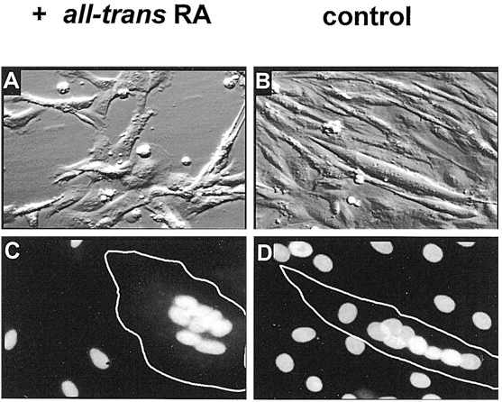
DIFFERENTIATED H9C2 CARDIOMYOCYTES
Notes:
We made use of embryonic rat-heart derived H9C2 cells to verify whether aspalathin can induce glucose uptake independent of insulin. Initially, these cells are immortal cells, but once differentiated by reducing the amount of serum in the culture medium and adding Retinoic Acid, the cells nucleus start to “clump together” and has a closer resemblance to the isolated cardiomyocyes. (NEXT)
J Biol Chem. 1999 Oct 8;274(41):29063-70.
Modulation of L-type calcium channel expression during retinoic acid-induced differentiation of H9C2 cardiac cells.
Ménard C¹, Pupier S, Mornet D, Kitzmann M, Nargeot J, Lory P.

Slide 42
ASPALATHIN INDUCES GLUCOSE UPTAKE IN H9C2 CELLS
N=4
*** : p<0.001
** : p<0.01
* : p<0.05
Notes:
Glucose uptake in differentiated H9C2 cells was assayed for 3 and 6 hours, and for both instances, Aspalathin induced a significant increase in glucose uptake, with 6 hours being more pronounced.

Slide 43
ASPALATHIN INDUCE GLUCOSE UPTAKE IN YOUNG AND CONTROL RATS
N=3
*** : p<0.001
** : p<0.01
* : p<0.05
Notes:
Returning to the rat models, we extended our experiments to 3 hours in the isolated cardiomyoctes. Surprisingly, incubating the Aspalathin for a mere 30mins longer than we did in our previous year’s experiments had a significant increase in glucose uptake in young controls, while the effect in conjunction with insulin was even more pronounced. This was also evident in diet controls with Aspalathin inducing a significant increase in insulin-mediated glucose uptake. The high fat diet group showed no significant increases when treated with Aspalathin. Also, no effect was visible after 1 and a half hours of treatment.

Slide 44
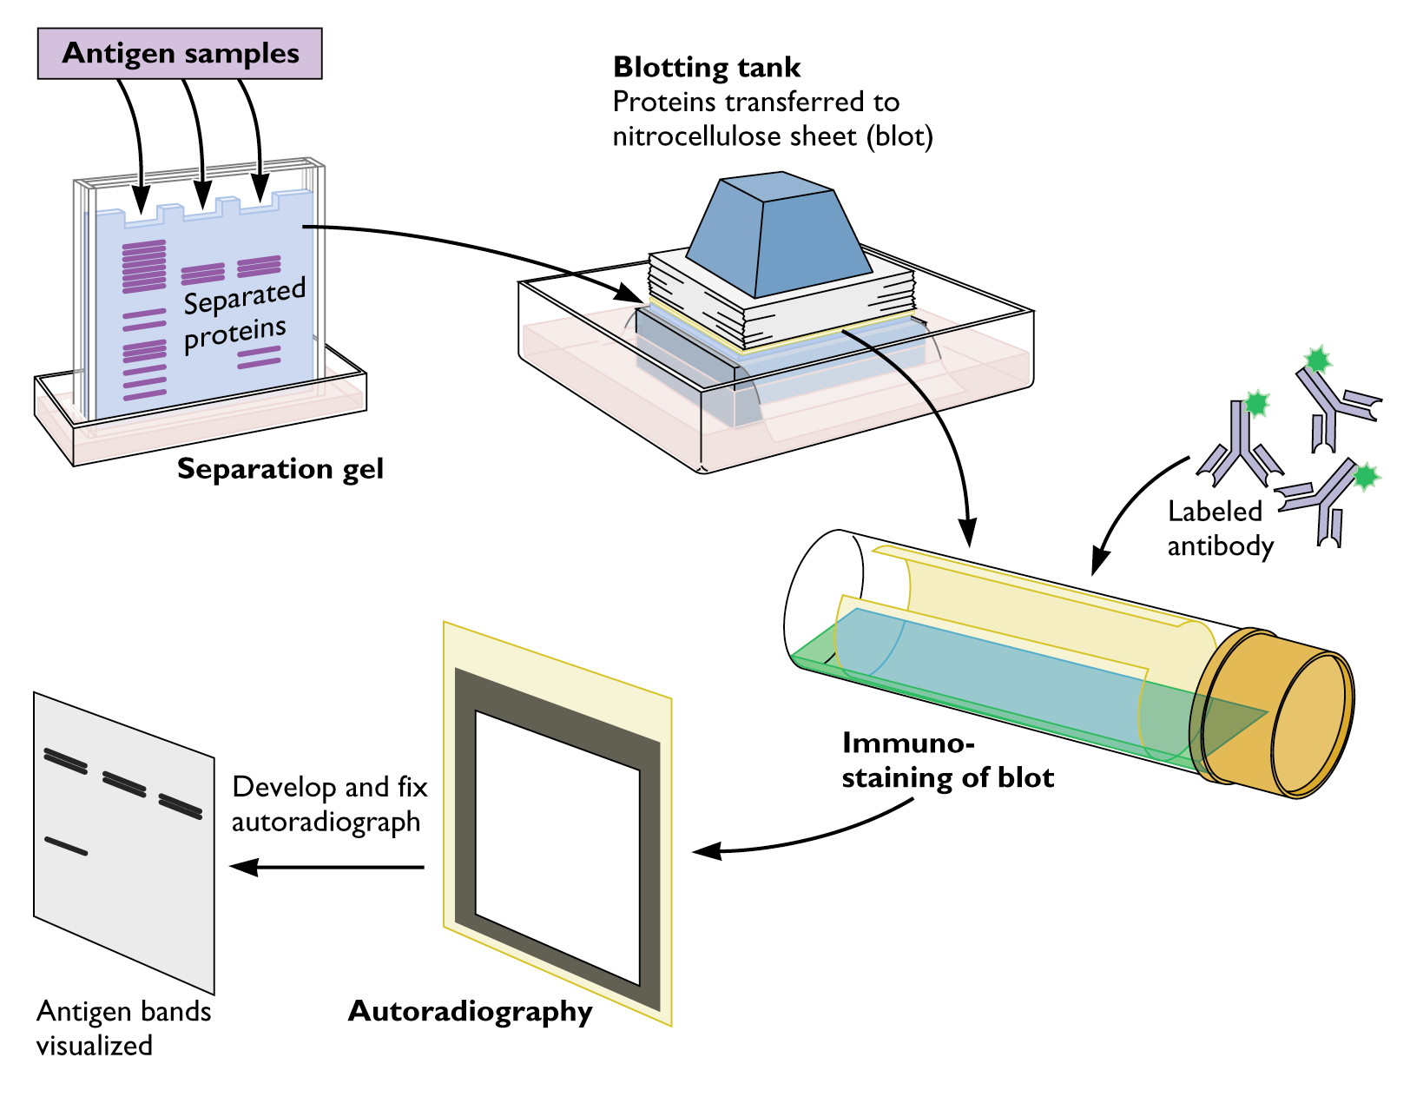
WESTERN BLOTTING
Notes:
We investigated the mechanism by which aspalathin induced this slight increase in myocardial glucose uptake by western blot analysis.
http://www.virology.ws/wp-content/uploads/2010/07/western_blot.jpg

Slide 45
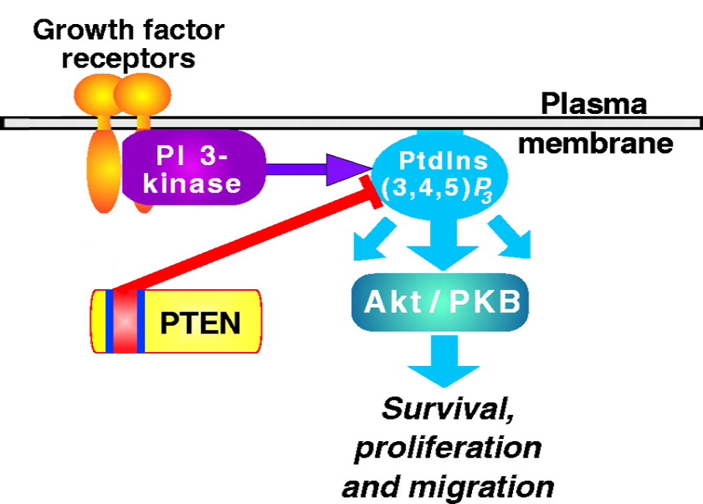
Notes:
In particular, the markers of interest was:
PKB, an insulin-dependent, pro-‘life’, growth marker. (NEXT)
http://jcs.biologists.org/content/114/13/2375/F2.large.jpg

Slide 46
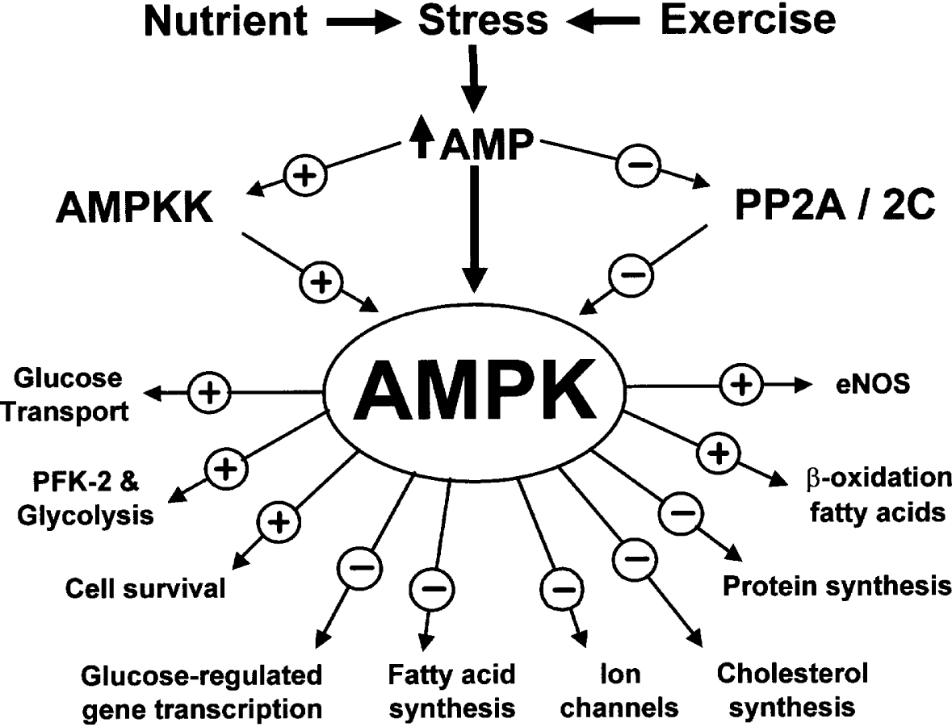
Notes:
And AMPK – the body’s key metabolic regulator, which is an insulin-independent marker of glucose uptake quite central to all cell signalling.
http://www.biochemsoctrans.org/bst/031/0162/bst0310162a01.gif

Slide 47
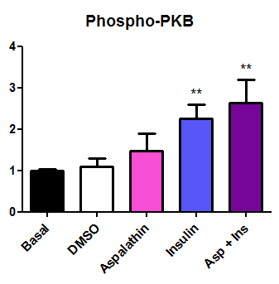
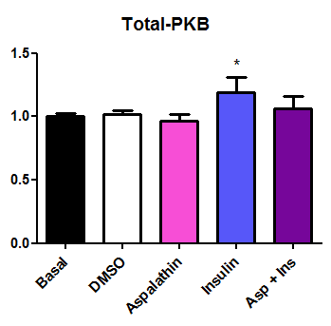

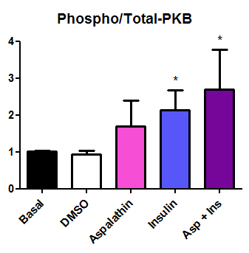
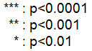
ACTIVATED
EXPRESSED
PKB
15 min
Treatment
N=6
Notes:
PKB activation was significantly increased in young rats treated for 15 minutes with both insulin and aspalathin. This effect was also observed when comparing the ratio of activated PKB to the total amount of PKB expressed. (NEXT)

Slide 48
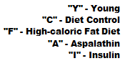
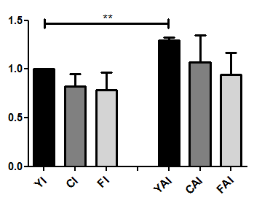
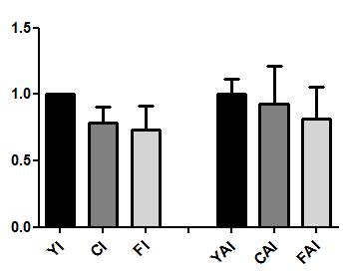
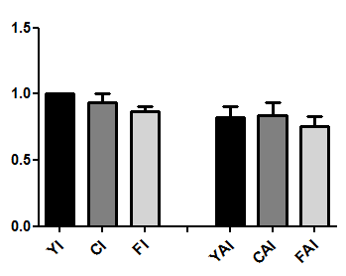
1h30m Treatment
P-PKB
T-PKB
P-PKB
__________________________________________________
T-PKB
N=3
Notes:
After 1 and a half hour of treatment, PKB activation was also significantly increased in aspalathin with insulin in young rats. No significant differences were found for the older diet rats.

Slide 49
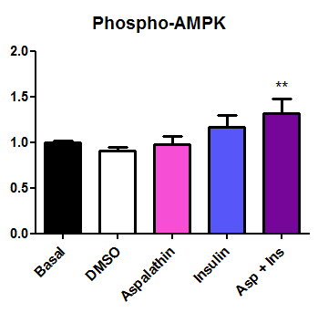
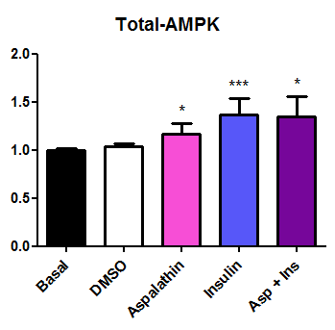

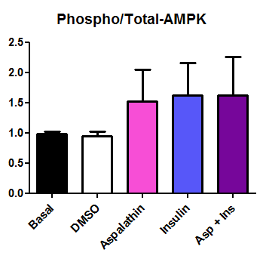
ACTIVATED
EXPRESSED
AMPK
15 min Treatment
N=3
Notes:
Aspalathin significantly increased AMPK activation WITH insulin, as well as increased the expression of AMPK in young rats after 15 minutes of stimulation.

Slide 50
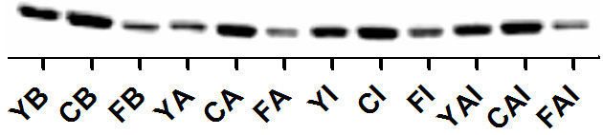
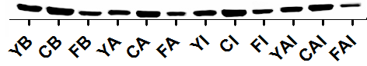
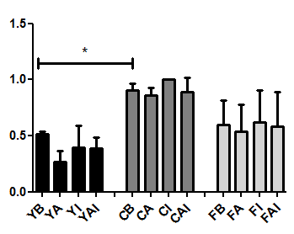
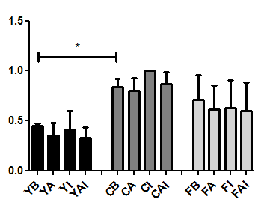
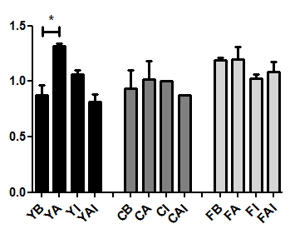
P-AMPK
1h30m Treatment
T-AMPK
"Y" - Young
"C" - Diet Control
"F" - High-caloric Fat Diet
"A" - Aspalathin
"I" - Insulin
"B" - Basal
P-AMPK
__________________________________________________
T-AMPK
N=3
Notes:
Aspalathin increased the phospho-to-total ratio of AMPK in young rats, possibly explaining the mechanism by which aspalathin induced glucose uptake at the hour and a half time point. Also, both expression and activation of AMPK was reduced in younger controls, compared to aged-diet controls. This might point towards AMPK becoming a more prominent metabolic regulator as ageing progresses.

Slide 51

ASPALATHIN
Notes:
Good, so in summary, the high-fat, high-sugar diet is an effective model to induce insulin resistance in rats.
Aspalathin induces myocardial glucose uptake directly in young rats and indirectly through mediating insulin’s action in aged control rats. The possible mechanism for this is through activation of PKB and increasing the expression and activation to expression ratio of AMPK. Aspalathin had no significant effect when used as treatment in heart cells from high-fat, high-caloric diet rats. (NEXT)

Slide 52
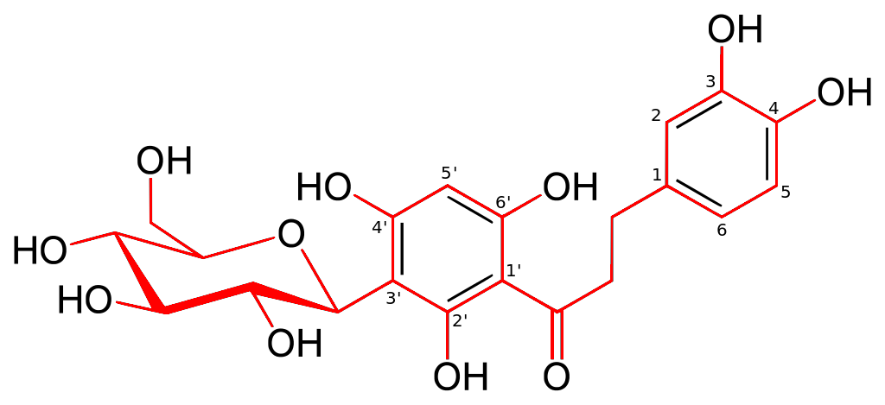
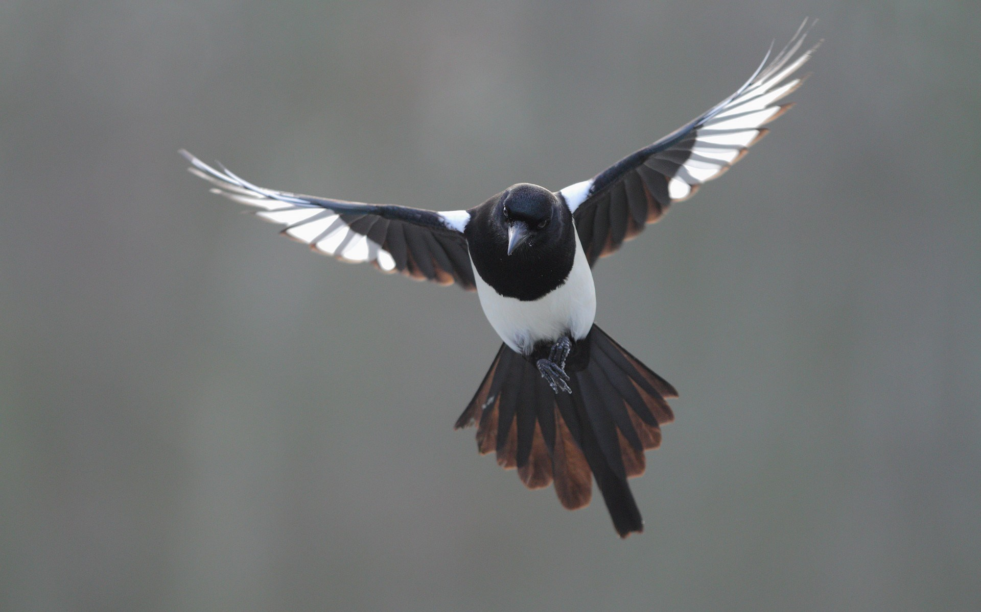
ASPALATHIN
Notes:
Good, so in summary, the high-fat, high-sugar diet is an effective model to induce insulin resistance in rats.
Aspalathin induces myocardial glucose uptake directly in young rats and indirectly through mediating insulin’s action in aged control rats. The possible mechanism for this is through activation of PKB and increasing the expression and activation to expression ratio of AMPK. Aspalathin had no significant effect when used as treatment in heart cells from high-fat, high-caloric diet rats. (NEXT)

Slide 53
SUMMARY
High-Fat, High-Sugar Diet caused Obesity and Insulin Resistance in Rats
Aspalathin induced myocardial glucose uptake:
DIRECTLY: Young Rats and Differentiated H9C2 Cells
INDIRECTLY: Older Control Rats
NO EFFECT: Obese, Insulin-Resistant Rats
Aspalathin
activated PKB (↑P-PKB)
increased expression and activation of AMPK (↑T-AMPK + ↑P-AMPK)
Notes:
Good, so in summary, the high-fat, high-sugar diet is an effective model to induce insulin resistance in rats.
Aspalathin induces myocardial glucose uptake directly in young rats and indirectly through mediating insulin’s action in aged control rats. The possible mechanism for this is through activation of PKB and increasing the expression and activation to expression ratio of AMPK. Aspalathin had no significant effect when used as treatment in heart cells from high-fat, high-caloric diet rats. (NEXT)

Slide 54



ACKNOWLEDGEMENTS
Prof. Barbara Huisamen (Supervisor)
Dr. Rabia Johnson,
Phiwa Dludla and the MRC
NRF for Funding
Notes:
I’d just like to thank the following people and orgnanisations for all their assistance and infrastructure, as well as acknowledge the NRF for all funding (NEXT)
http://www.youthvillage.co.za/wp-content/uploads/2014/09/NRF.jpg
http://www.pssaconference.co.za/sites/all/themes/eventme/img/pssa-logo-2015.png

Slide 55
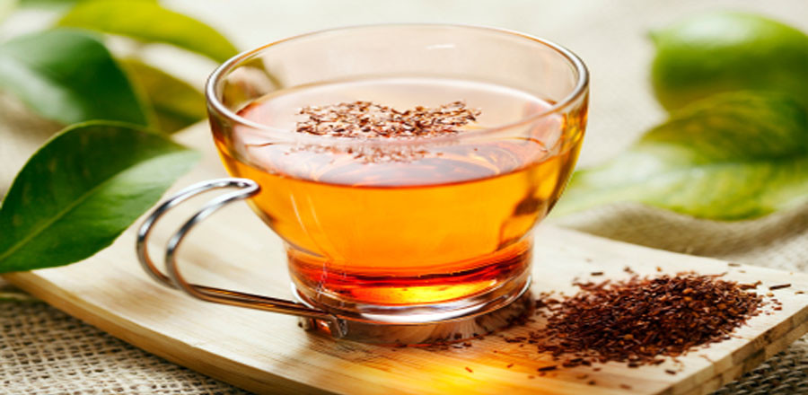
Thank You
Notes:
Thank you very much.
http://greenlifediary.com/wp-content/uploads/2012/08/health-benefits-of-rooibos-tea-900x440.jpg

Slide 56


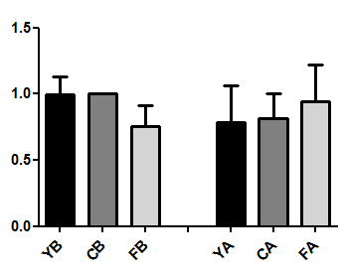
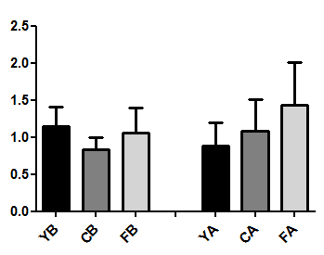

1h30m Treatment
P-PKB
T-PKB
"Y" - Young
"C" - Diet Control
"F" - High-caloric Fat Diet
"A" - Aspalathin
"B" - Basal
P-PKB
__________________________________________________
T-PKB
N=3

